Slide 1
ENSE 496ab Milestone 4
MudsnakeFC
Zain Chowdhary, Connor Meredith, Demitri Kourles, Xiaojie Chen, Jinpeng Chen, Shuaihao Zhao
Nov. 15, 2018

Slide 2
Team introductions
Team members
Zain Chowdhary, Connor Meredith, Demitri Kourles, Jinpeng Chen, Xiaojie Chen, Shuaihao Zhao
Team name
Mudsnake FC

Slide 3
Roles and Responsibilities
Zain Chowdhary: Notification Icon and view feedback from icons, bug fixing
Connor Meredith: All filters and the search bar, bug fixing
Jinpeng Chen: Powerpoint
Shuaihao Zhao: Consent form and pre-task questionnaire documentation
Demitri Kourles, Xiaojie Chen: Task questionnaire, post-task questionnaire, testing code

Slide 4
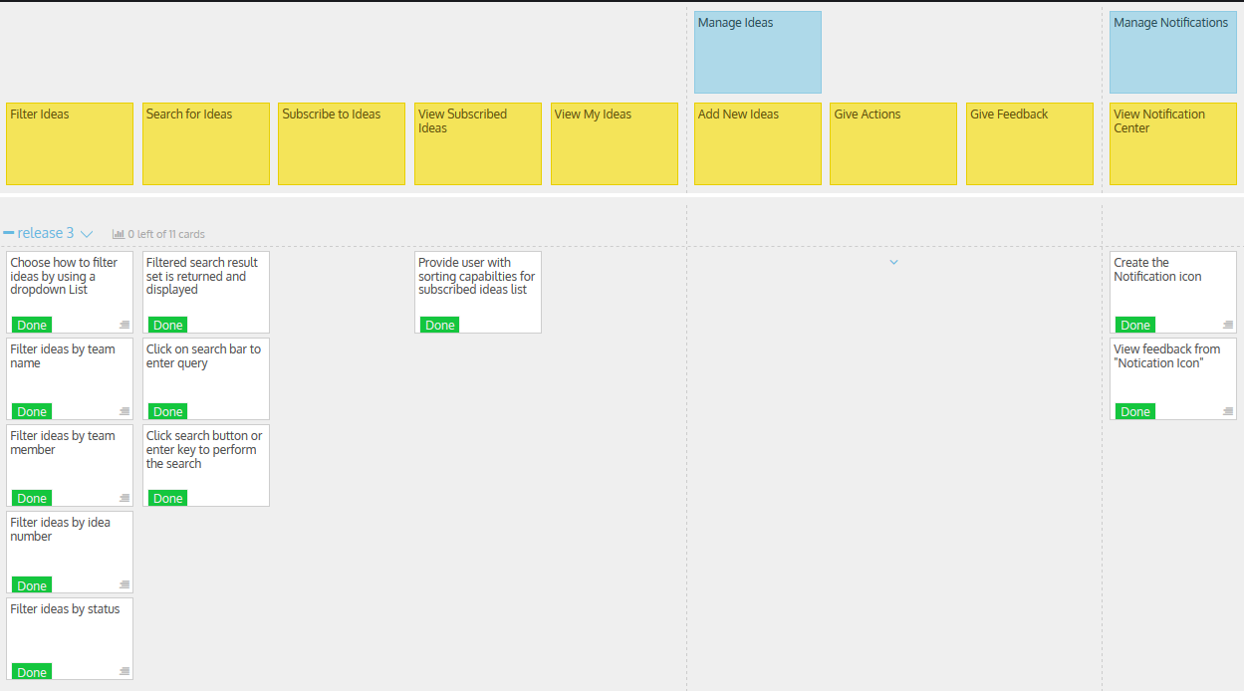
USM review (release 3)

Slide 5
USM review (release 3)
What was envisioned?
Filter Ideas by different categories.
Search ideas, search results generated dynamically.
Users have the ability to sort subscribed ideas
Notification when the status of an idea is changed.
Did things stay the same or change?
There is no designated search page. Each page just has a search box that dynamically searches as the user types.

Slide 6
USM review (release 3)
Rationalize your MVP
After the first two release, most of the functions of our applications are complete. For this release we added the ability to filter ideas by categories and search ideas to increase the usability of the application. Also added the notifications for status changes and comments.
Discuss time management
We set up meeting after class on Tuesday’s and/or Thursday’s to delegate tasks for the milestone and help each other with any issues.

Slide 7

MVP/Sprint-3 Demo

Slide 8
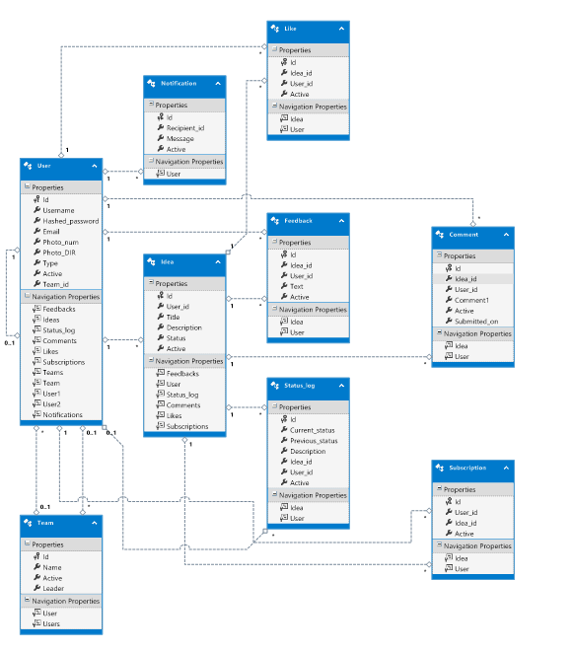
MVP/Sprint-3 Demo

Slide 9
Comments/Discussion
Successes
We achieved every goal that we set for this release. We also fixed some of the bugs from previous milestones and refactored some of the code.
Barriers to success
The delegation of tasks between six people is still somewhat difficult. Since we don’t have that much to code in this release. We decided to have two people for coding and rest of us doing the documentation as well as preparing for our trip to eHealth next week.
Was everything good, or would stuff & things have been better if…
Nothing to mention considering we achieved all of our goals for this release.

Slide 10
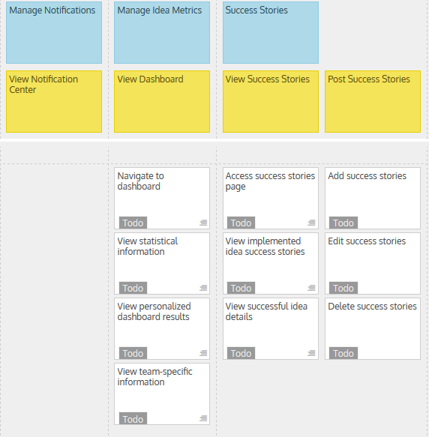
USM for MVP/Sprint-4

Slide 11
USM for MVP/Sprint-4
Address key deliverables/revisions
View Dashboard
View successful ideas
Post success stories
Address and rationalize why the MVP/Sprint-4 can be considered as such
Now that we have implemented the main functions of our application, the goal of our next release is to give users the ability to view some dashboard analytics and success stories. This should further improve the overall user experience of our application.

Slide 12
Group reflection
How did you feel about this milestone? What did you like about it? What did you dislike?
We felt good about this milestone since we didn’t have too many features to implement.
What did you learn about yourself as you collaborated and worked through this milestone?
Each group member has different skills, some are good at coding and the others are good at doing documentations. Delegating tasks to different member allows us more freedom to work.
How will you use what you have learned going forward?
We learn that documentations are the important part of application development. We can apply what we have learned into future projects.
What“stuff & things" related to this milestone would you want help with?
No problems in particular

